Slide 1


Harnessing data for storytelling
How data journalism transforms complex data into insight.

Slide 2





Why now?
Open data
culture.
Data literacy
demand.
Digital and data tools have become free and accessible to the changing media industry.

Slide 3



Why it matters
“ Data journalism is the art and practice of finding stories in data…and then retelling them.” –School of Data
Data journalism cuts across sectors.
It transforms journalism into
a powerful tool
for accountability
and constructive engagement.
It analyses complex dynamics that cause political and development initiatives to succeed or fail, people to become sick or well and inequality to grow or shrink.

Slide 4

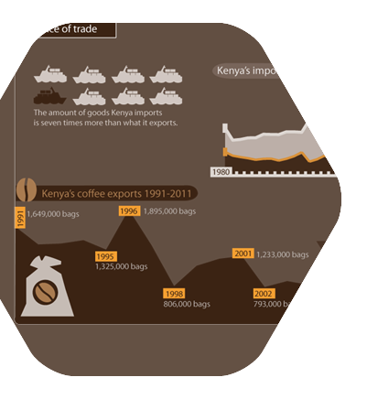

The approach
Data
- brings together data collected by media, civil society organisations, government bodies and academics.
Demand
focus on key development challenges that society wants to solve.

Slide 5
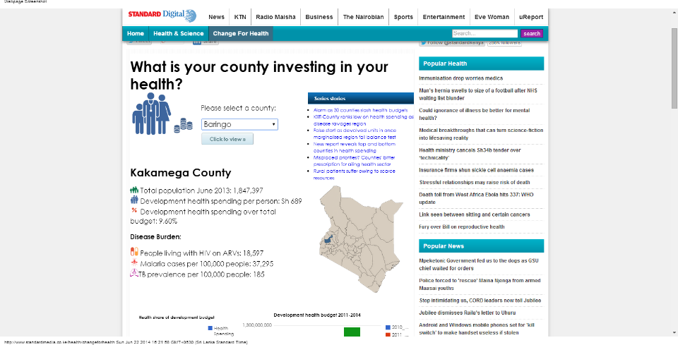
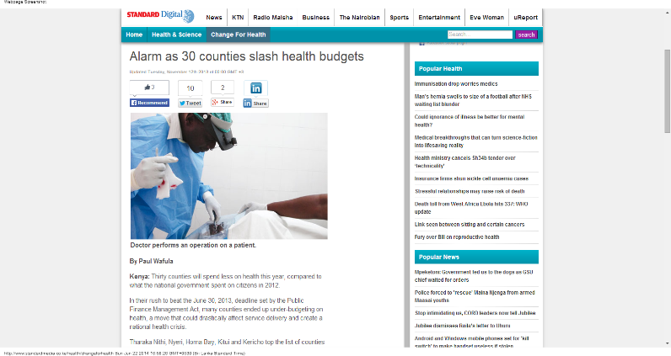
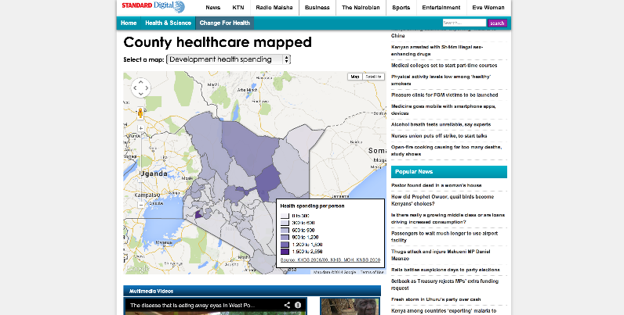
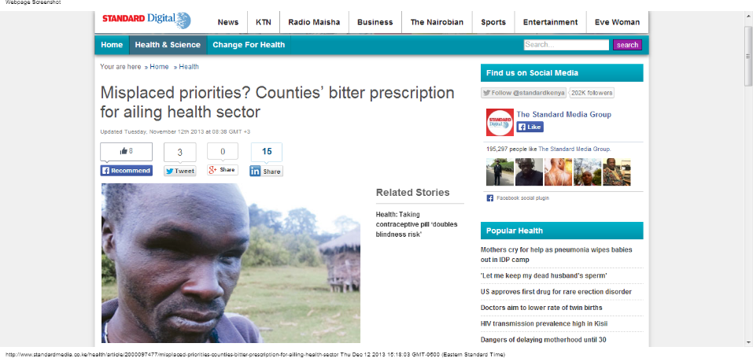

Slide 6
Findings from the data

Slide 7
Findings from Public Demand

Slide 8




Our approach
- Recognizes that learning data skills requires commitment through open data communities and cross-border projects.
Design
Dissemination
distributes content through accessible narrative and visualizations through information channels known and trusted by the public

Slide 9
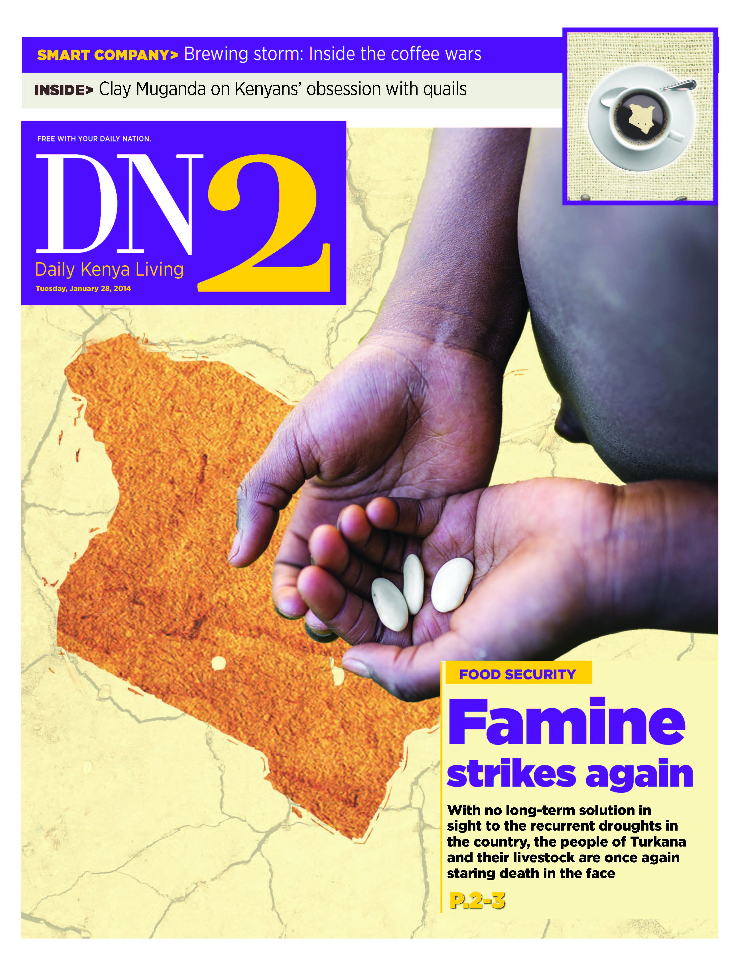
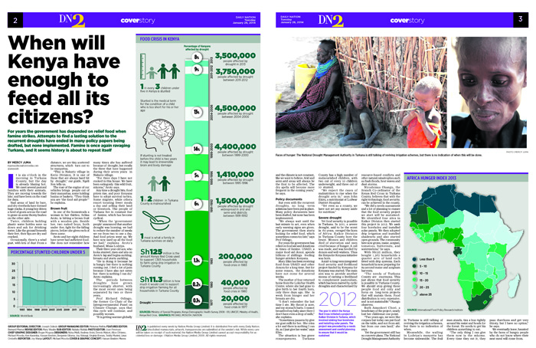
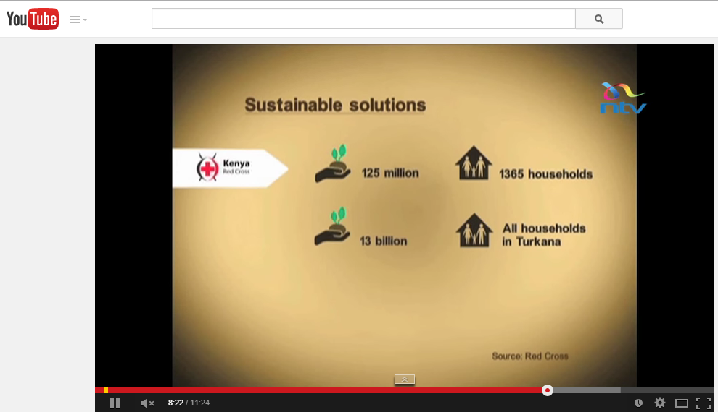

Slide 10
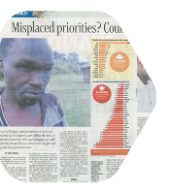
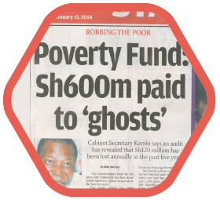
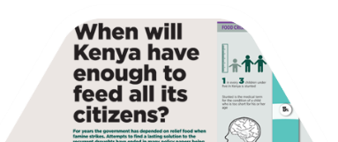
Impact & policy change
Took the health funding debate to the county level by providing access to data on health spending, leading to nationwide county budget portals.
Made the minister order an audit and the Labor Cabinet Secretary reveal that Sh600 million were handed out to ghost recipients. Enlisted Safaricom, to help distribute the funding.
Set the news agenda. Main character got assistance and a relief fund for Turkana County was set up jointly with Red Cross and food security plan advanced.

Slide 11

Inspiring storytelling
Journalists who have participated in data workshops have investigate the financial impact of military incursions, tracked the impact of elections on illegal arms smuggling and uncovered the reasons behind environmental degradation in fragile ecosystems.
Deforestation in the Amazon is larger than estimated.
InfoAmazonia
Israeli army incursions threatens sales markets in the West Bank
Araby Aljadid
Failure of Anti-Narcotis Program
Payk
Economic losses as a result of the military campaign in Hebron.
Alqud TV
Gun prices spike ahead of Afghan elections Payk
Oil and Water: Donor and Investor Interests Collide in Turkana EL MUNDO

Slide 12
Data Journalism Tools
-Excel, SPSS, Investigative Dashboard and a lot of help from data scientists in the open data community
Analysis
Google Masterfile to track: assignments, sources, data, interviews, multimedia production.
Coordination
Google Fusion tables, Adobe Illustrator, Adobe After Effects
Storytelling

Slide 13
Investigative Data Journalism
-Efforts like Swiss Leaks, Global Leaks, Open Corporates, Investigative Dashboard and the SEC database makes it easier than effort to map power structures.
Corporate ownership
Scrutinizes public spending & government efficiency through burn rates, MP expenses and contracting practices.
Where does my money go?
Coverage of gender issues that can explain and remedy the gender gap.
Gender Inequality

Slide 14




Partners

Slide 15









Funders

Slide 16
Contact
Eva Constantaras
evaconstantaras@gmail.com
@evaconstantaras

